Slide 1


Slide 2


Slide 3
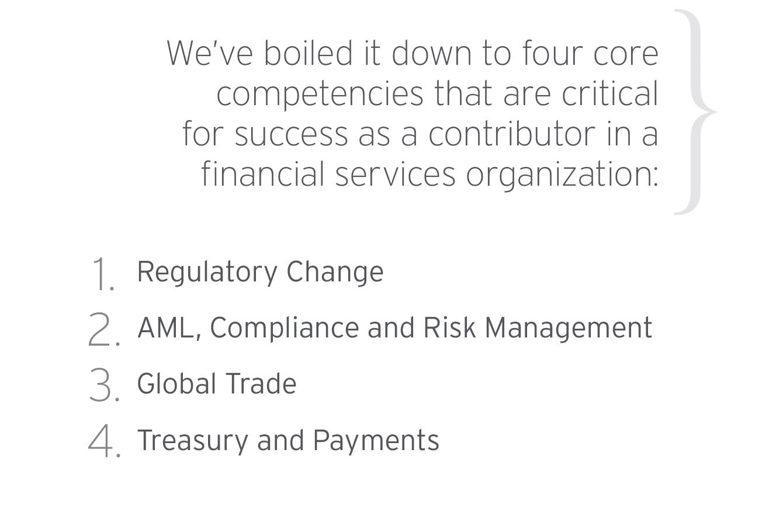

Slide 4

Understanding Changes to ISBP
Pamela Woon, Regional Trade Advisor
Citi Transaction Banking Academy for Financial Institutions Professionals | August 2014

Slide 5


Changes
  Separates practices by Sections (A to Q)
  New inclusions not appearing in previous publication
  Expands the application more than what stated in ISBP 681
  Easier to understand, provides further clarity
  Each section address a particular UCP article relative to each practice (Transport documents, drafts, invoices etc)
  Addresses other documents not considered in publication 681 (P/List, W/List, Beneficiary Certificates and other type of certificates ( Analysis, Inspection, Health, etc.))

Slide 6
Comparison – ISBP 681 vs. ISBP 745
ISBP 681 | ISBP 2013 Revision
Preliminary Considerations | 5 | Preliminary Considerations | 7
General Principles | 37 | General Principles (A1 – A41) | 41
Drafts and Calculation of Maturity Date | 14 | Drafts and Calculation of Maturity Date (B1 – B18) | 18
Invoices | 11 | Invoices (C1 – C15) | 15
Transport Document Covering at Least Two Different Modes of Transport | 23 | Transport Document Covering at Least Two Different Modes of Transport (“multimodal or combined transport document”) (D1 – D32) | 32
Bill of Lading | 24 | Bill of Lading (E1 – E28) | 28
(NONE) |  | Non-Negotiable Sea Waybill (F1 – F25) | 25
Charter Party Bill of Lading | 19 | Charter Party Bill of Lading (G1 – G27) | 27

Slide 7
Comparison – ISBP 681 vs. ISBP 2013 Revision (Cont’d)
Air Transport Document | 23 | Air Transport Document (H1 – H27) | 27
Road, Rail or Inland Waterway Transport Document | 13 | Road, Rail or Inland Waterway Transport Document (J1 – J20) | 20
Insurance Document and Coverage | 11 | Insurance document and Coverage (K1 – K23) | 23
Certificate of Origin | 5 | Certificate of Origin (L1 – L8) | 8
(NONE) |  | Packing List, Note or Slip (“Packing List”) (M1 – M6) | 6
(NONE) |  | Weight List, Note or Slip (“Weight List”) (N1 – N6) | 6
(NONE) |  | Beneficiary’s Certificate (P1 – P4) | 4
(NONE) |  | Analysis, Inspection, Health, Phytosanitary, Quantity, Quality and Other Certificates (“certificate”) (Q1 – Q11) | 11
Total | 185 | Total | 298

Slide 8




Question Time!
  The examination of documents is to be completed according to the terms and conditions of the credit and UCP 600.
  ISBP, publication 681 or 745, only provides an explanation of how to interpret UCP 600.
  Since most of publication 681 is covered in 745, it is recommended that ISBP 745 be used as the basis for examination of documents.
Topic : Examination subject to publication 681 or 745
A credit is issued before the publication of ISBP 745 and had stated “the applicable rule: UCP latest version” .
Should the examination of documents under that credit be subject to ISBP 681 or ISBP 745?

Slide 9


PRELIMINARY CONSIDERATIONS
Scope of the publication
i – (New)
to be read in conjunction with UCP 600 and not in isolation.
ii – (New)
Practices described highlight how articles of UCP 600 are to be interpreted and applied to
credit and do not expressly modify or exclude an applicable article in UCP 600.

Slide 10




Abbreviations
A1 – (expands Para 6)
Credit includes an abbreviation in its text allows document to show
the same abbreviation or any other abbreviation that has the same
meaning, or to show the complete spelling of the word or vice versa.
A2,a – (expands Para 7)
Virgules (i.e., slash marks “/”) when used with no context is to be understood as follows:
“Red/Black/Blue” - only Red OR only Black OR only Blue OR any combination of them.
A2,b – (New)
Comma (“,”) when used to indicate a range of data with no context is to be understood as follows:
“Port of Loading: Hamburg, Rotterdam, Antwerp” - only Hamburg OR only Rotterdam OR only Antwerp OR any combination of them.

Slide 11

Certificates, Certifications, Declarations and Statements
A4 – (expands Para13)
needs to be dated depends on the type that has been requested,
its required wording and the wording that appears within the
document.
LC Certification Requirement:
The vessel is no more than 25 years old
To Comply :
Certify the date or year the vessel was built
=> such date is no more than 25 years prior to shipment date **
=> Date of issuance not required
Certify as to the wording as stated in the credit
=> Date of issuance is required.
✗ 
Date if Issuance :
We certify that the vessel was built October 10, 1994 **
Date of Issuance:
We certify that the vessel is no more than 25 years old
✓

Slide 12




Case Study: Identify the Discrepancies
NO | DICREPANCIES
1 | Invoice not issued by beneficiary as per LC
2 | Invoice showing “CIF , Malaysia, Incoterm 2010” i/o “CIF, Malaysia
3 | Inspection Certificate dated after the Shipment date
4 | Inspection Certificate not in the language of the Credit
5 | Insurance does not evidence “All Risk” coverage
6 | Insurance shows exclusion of “Theft Pilferage and Non Delivery”
7 | Insurance is dated after the Shipment date
8 | Bill of Lading not signed as per UCP
9 | Port of Loading does not show Country Name as per LC
10 | B/L does not have on board notation

Slide 13
THANK YOU
Strictly Private and Confidential

Slide 14
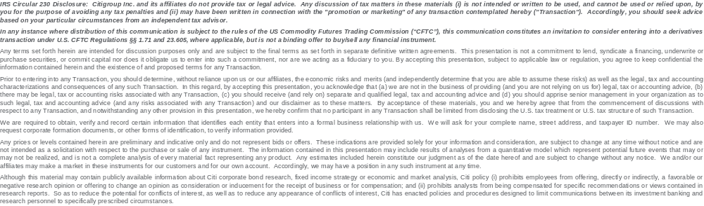
[TRADEMARK SIGNOFF: add the appropriate signoff for the relevant legal vehicle]
© 2014 Citigroup Global Markets Inc. Member SIPC. All rights reserved. Citi and Citi and Arc Design are trademarks and service marks of Citigroup Inc. or its affiliates and are used and registered throughout the world.
© 2014 Citigroup Global Markets Limited. Authorized and regulated by the Financial Services Authority. All rights reserved. Citi and Citi and Arc Design are trademarks and service marks of Citigroup Inc. or its affiliates and are used and registered throughout the world.
© 2014 Citibank, N.A. All rights reserved. Citi and Citi and Arc Design are trademarks and service marks of Citigroup Inc. or its affiliates and are used and registered throughout the world.
© 2014 Citigroup Inc. All rights reserved. Citi and Citi and Arc Design are trademarks and service marks of Citigroup Inc. or its affiliates and are used and registered throughout the world.
© 2014 [Name of Legal Vehicle] [Name of regulatory body.] All rights reserved. Citi and Citi and Arc Design are trademarks and service marks of Citigroup Inc. or its affiliates and are used and registered throughout the world.
Citi believes that sustainability is good business practice. We work closely with our clients, peer financial institutions, NGOs and other partners to finance solutions to climate change, develop industry standards, reduce our own environmental footprint, and engage with stakeholders to advance shared learning and solutions. Highlights of Citi’s unique role in promoting sustainability include: (a) releasing in 2007 a Climate Change Position Statement, the first US financial institution to do so; (b) targeting $50 billion over 10 years to address global climate change: includes significant increases in investment and financing of renewable energy, clean technology, and other carbon-emission reduction activities; (c) committing to an absolute reduction in GHG emissions of all Citi owned and leased properties around the world by 10% by 2011; (d) purchasing more than 234,000 MWh of carbon neutral power for our operations over the last three years; (e) establishing in 2008 the Carbon Principles; a framework for banks and their U.S. power clients to evaluate and address carbon risks in the financing of electric power projects; (f) producing equity research related to climate issues that helps to inform investors on risks and opportunities associated with the issue; and (g) engaging with a broad range of stakeholders on the issue of climate change to help advance understanding and solutions.
Citi works with its clients in greenhouse gas intensive industries to evaluate emerging risks from climate change and, where appropriate, to mitigate those risks.
efficiency, renewable energy and mitigation

Slide 15
声明：
所有的版权属于原有公司，文件均来自公开渠道
此文件仅供学习使用，任何人不得进行以此为商业目的的行为
如有疑问，请立即删除
学习世界五百强和咨询公司PPT课程请访问如下网站搜索：“司马懿”
百度传课：司马懿PPT学校
https://www.chuanke.com
网易学堂：司马懿PPT学校
https://study.163.com
知乎： 司马懿PPT学校
https://www.zhiu.com

